Slide 1

A presentation by James Davies

Slide 2
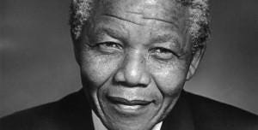
Nelson Mandela

Slide 3
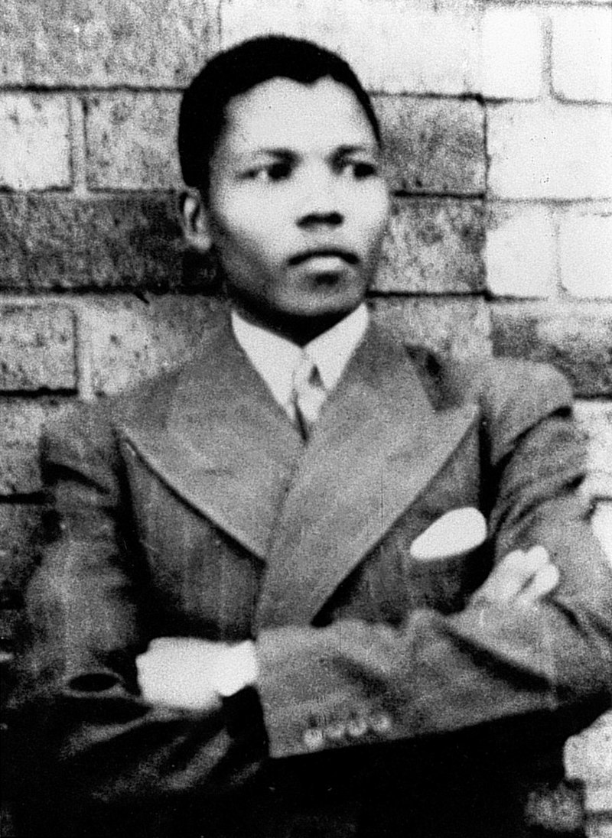
Born Rolihlahla Mandela into the Thembu Royal Family
Began university study 1939
at the university of Forte Hare
1943 he continued his studying in ‘Law’ at the
University of Witwatersrand
Mandela Joined the ANC

Slide 4
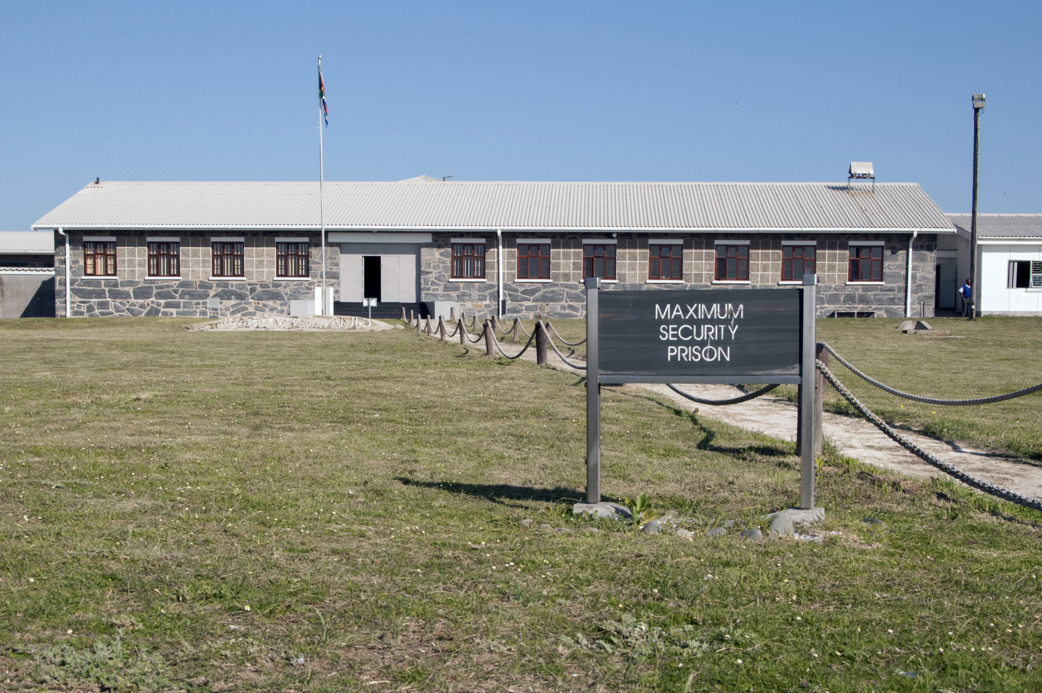
July 1952 was arrested and stood trial
Found guilty of ‘statutory communism’
August 1962 captured and arrested
charged with ‘inciting workers to strike’
1964 Imprisoned on a life sentence

Slide 5
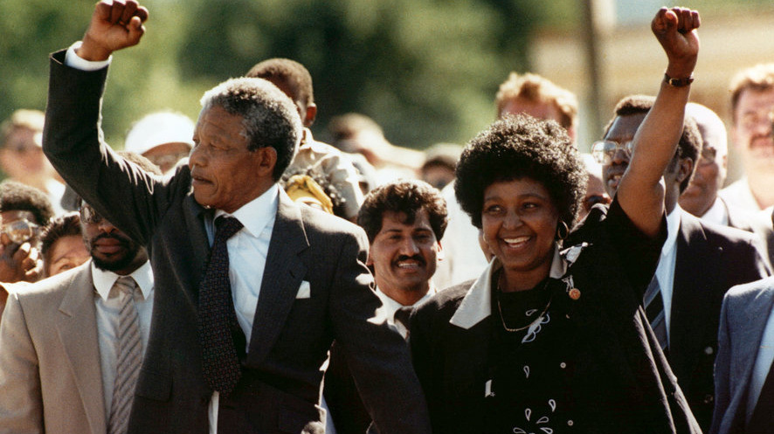
Release from Prison 11th February 1990
Served a total of 27 years in jail
Became the first Black S.A. President

Slide 6
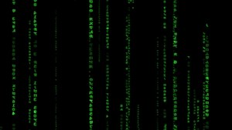
But wait…. This story isn’t over....

Slide 7
Question 1:
In the movie: ‘Star Wars: The Empire Strikes Back’ there is a famous scene where Darth Vader confronts Luke Skywalker to tell him what is one of the classic plot twists in movie history. What was the line he used?
If you said: “Luke, I am your father” then…..
I’m sorry, you are wrong the actual line was:
“No! I am your father!”

Slide 8


Question 2:
The Pokémon character; Pikachu, Which is the correct image?
Correct!
Incorrect!

Slide 9
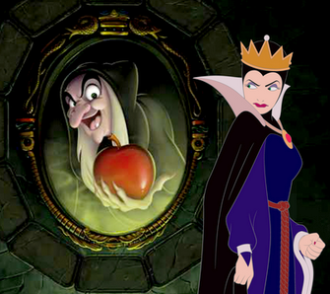
Question 3:
In the Disney movie: ‘Snow White and the seven dwarfs’, what magic incantation does the evil queen say to her mirror?
If you said: “Mirror, mirror on the wall…” then…..
I’m sorry, you are wrong, the actual line was:
“Magic mirror on the wall…”

Slide 10
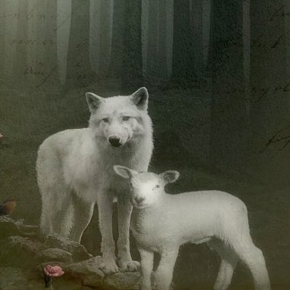
Finally, Question 4:
In the Bible, what animal does Isaiah say will ‘Lie down with the lamb’?
If you said: ‘The lion’ then…..
I’m sorry, you are wrong, the actual answer is:
‘The wolf also shall dwell with the lamb…’
-Isaiah 11:6

Slide 11

Conspiracies
We are in the Matrix
Government memory implantation program
CERN zapped us into a parallel universe
More likely false memories and misinformation

Slide 12
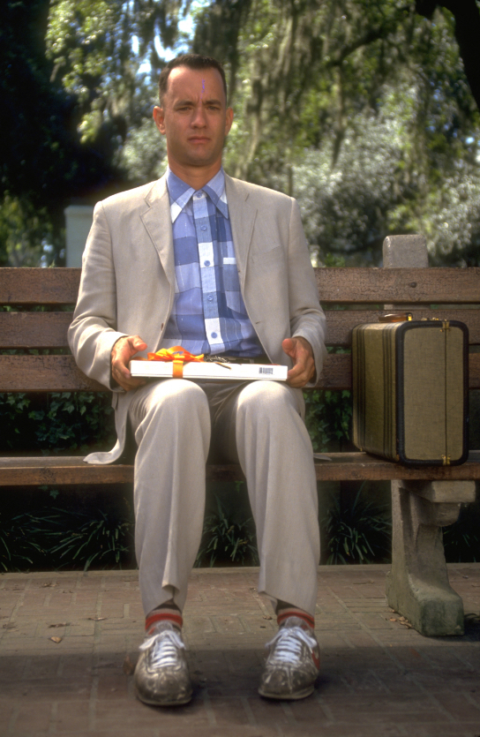
Thanks. Any Questions?

